Slide 1


Various methods for
Environmental data handling
(Statistical Model,
Machine Learning Algorithm)
국립환경과학원 영산강물환경연구소
연구사 황성윤

Slide 2
contents
01
Introduction
02
Statistical Models
03
Machine Learning Algorithms
Notes:
.

Slide 3
01
Introduction

Slide 4
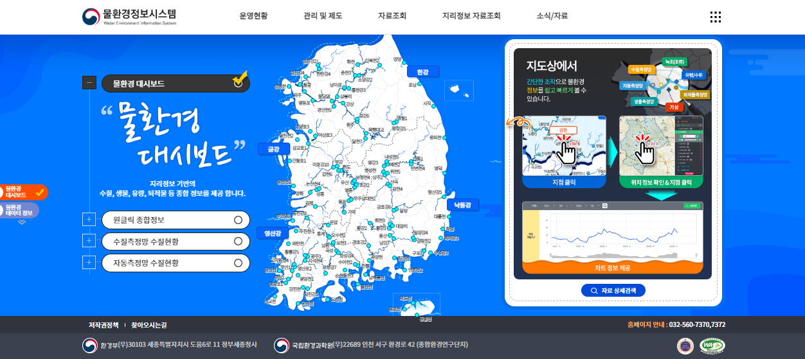
1. Introduction
Environmental Data Handling (Water Environment Information System)

Slide 5
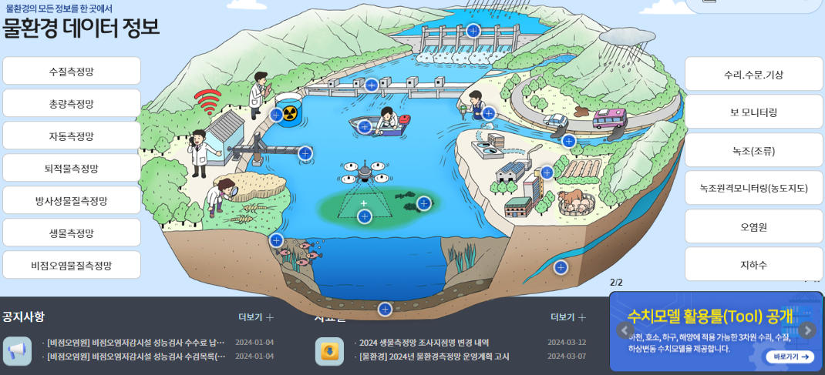
1. Introduction
Environmental Data Handling (Water Environment Information System)

Slide 6
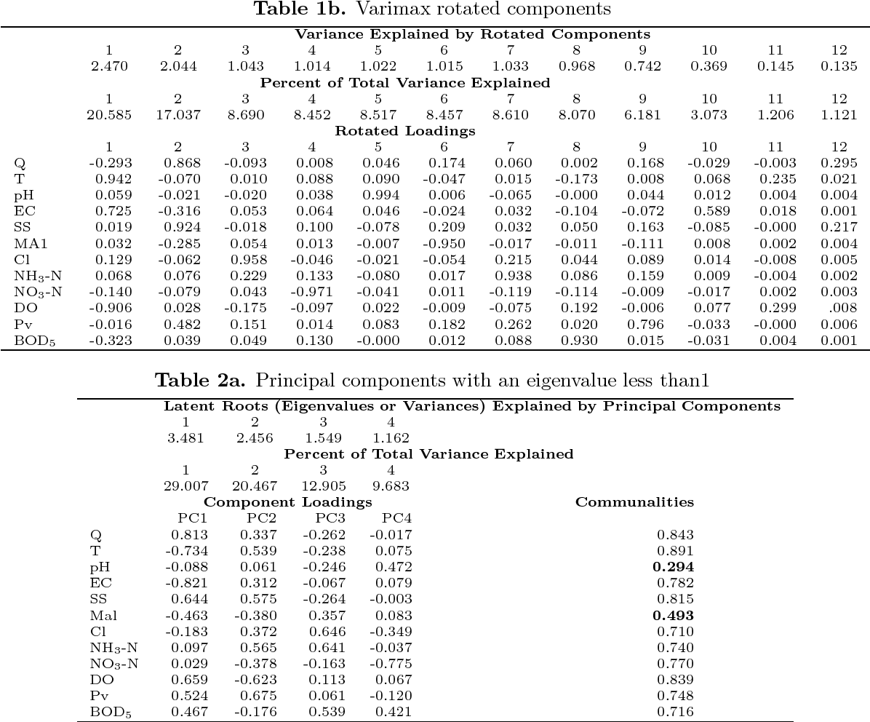
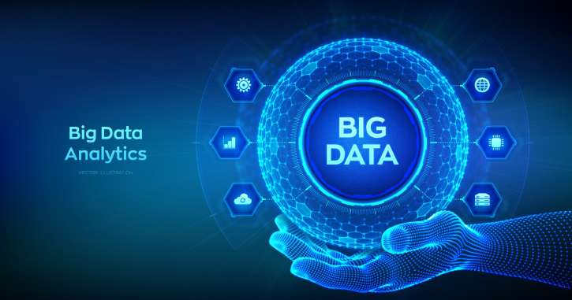
1. Introduction
Environmental Data Handling

Slide 7

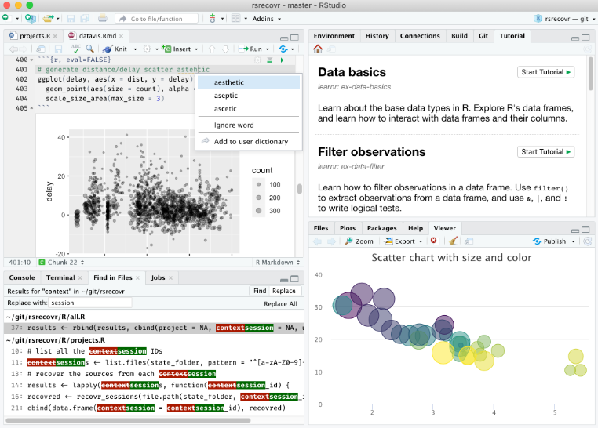
1. Tool for data analysis
2. R
(1) 통계 계산과 그래픽을 위한 프로그래밍 언어이자 소프트웨어 환경
(2) 1960년대와 1970년대 Bell 연구소에서 개발된 S language에 기반을 두고, 1990년대 중반 뉴질랜드 오클랜드 대학의 로스 이하카와 로버트 젠틀맨에 의해 시작
(3) GPL 하에 배포되는 공개 소프트웨어로 누구나 자유롭게 이용할 수 있으며 자발적 기여자들에 의해 지속적으로 개발 중임
(4) 대표적 특징
1) 효율적이고 편리한 데이터 조작 및 처리
2) 데이터를 다양한 그래프로 표현해주는 데이터 시각화 기능
3) 통계 분석 및 데이터 마이닝 알고리즘 수행
4) 간단하며 효과적인 프로그래밍 언어로서의 기능

Slide 8

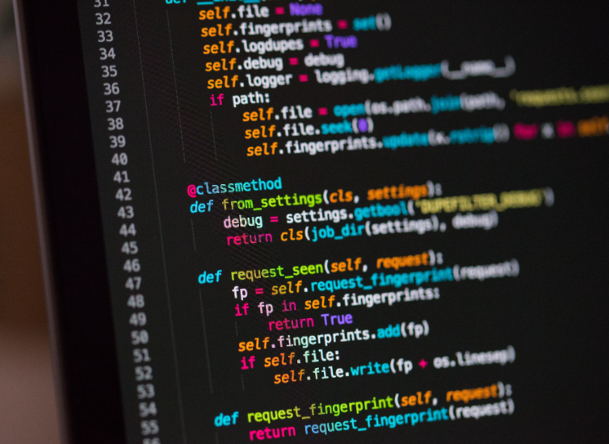
1. Tool for data analysis
3. Python
(1) 1991년 네덜란드계 소프트웨어 엔지니어인 귀도 반 로섬에 의해 개발된 고급 프로그래밍 언어
(2) 플랫폼에 독립적이며 객체 지향적, 동적 타이핑 대화형 언어
(3) 강력한 라이브러리와 풍부한 생태계를 통해, 데이터를 수집하고 분석하며 시각화할 수 있음
(4) 대표적 특징
1) 문법이 쉬워 빠르게 배울 수 있음
2) 무료이지만 강력한 데이터 처리기능 보유
3) 간결한 형식의 코딩
4) 개발 속도가 빠르며 인공지능 기반 model에 특화되어 있음

Slide 9
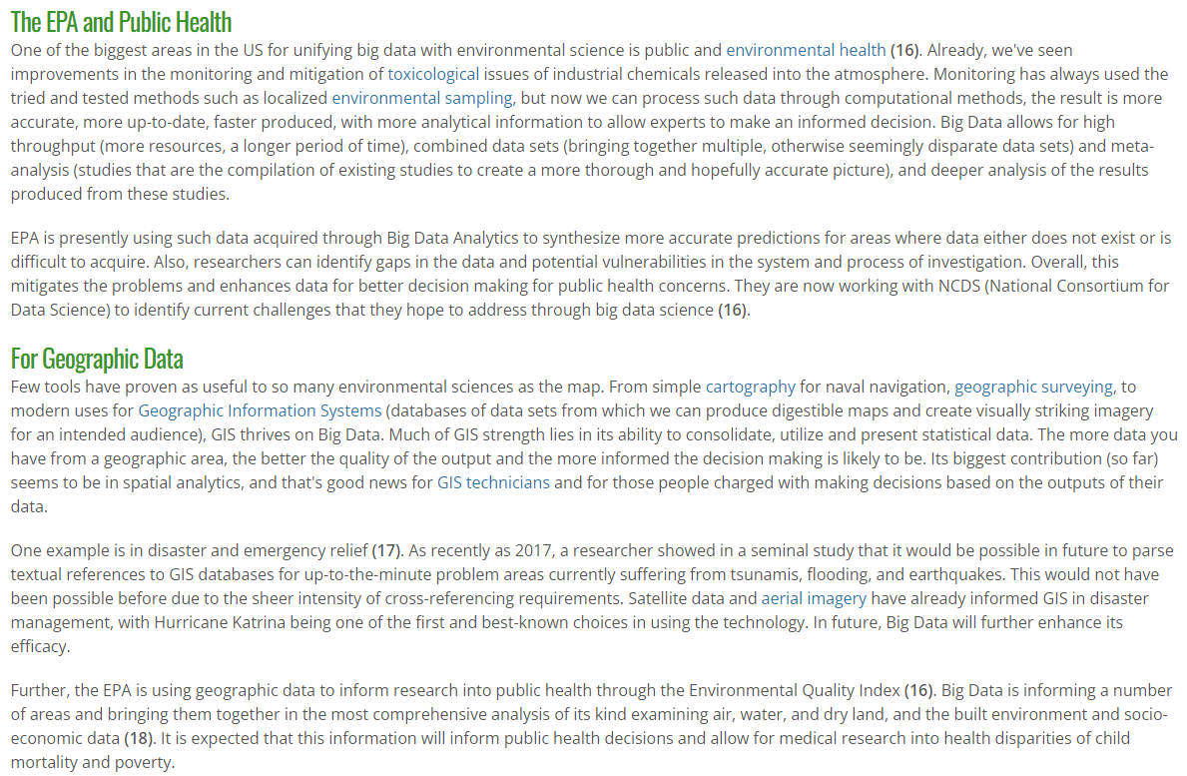
1. Big data for environmental science
Reference : https://www.environmentalscience.org/data-science-big-data

Slide 10
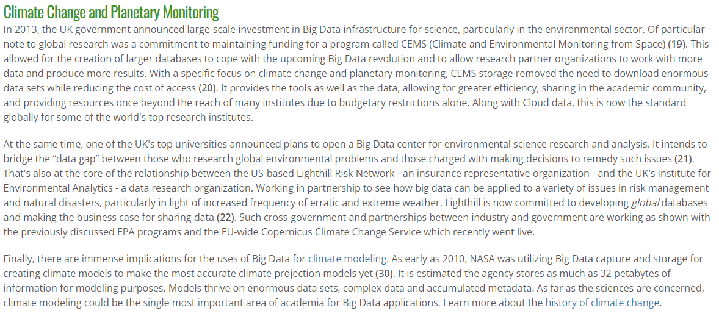
1. Big data for environmental science
Reference : https://www.environmentalscience.org/data-science-big-data

Slide 11
02
Statistical Models

Slide 12
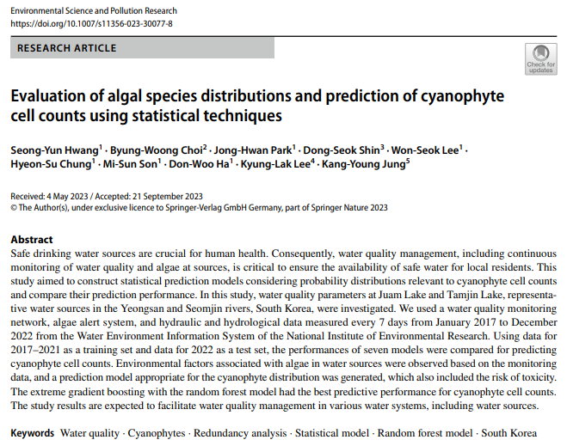
2. Statistical Models
Evaluation of algal species distributions and prediction of cyanophyte cell counts using statistical techniques

Slide 13
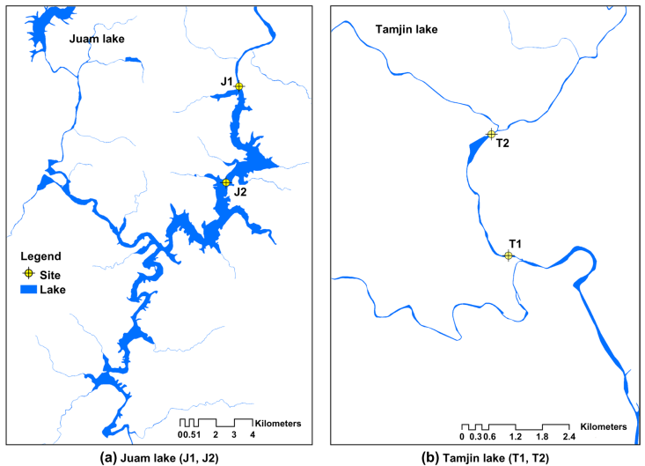
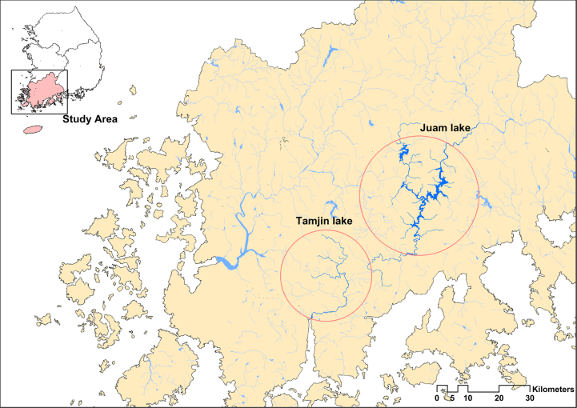
2. Statistical Models
Evaluation of algal species distributions and prediction of cyanophyte cell counts using statistical techniques

Slide 14
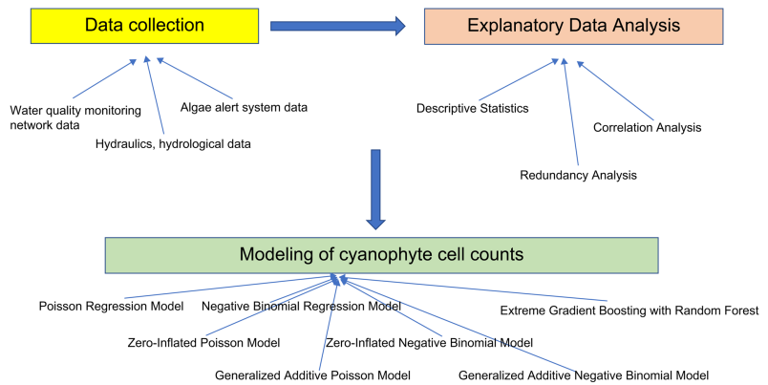
2. Statistical Models
Evaluation of algal species distributions and prediction of cyanophyte cell counts using statistical techniques

Slide 15
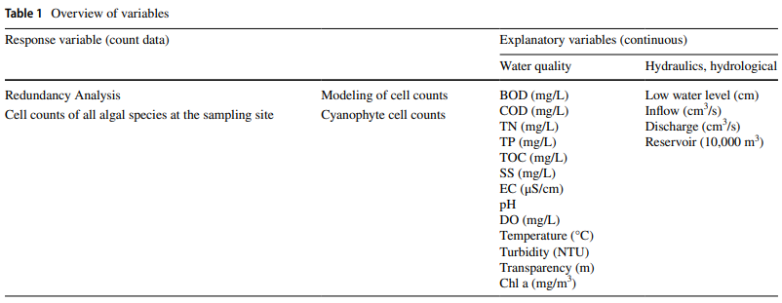
2. Statistical Models
Evaluation of algal species distributions and prediction of cyanophyte cell counts using statistical techniques

Slide 16
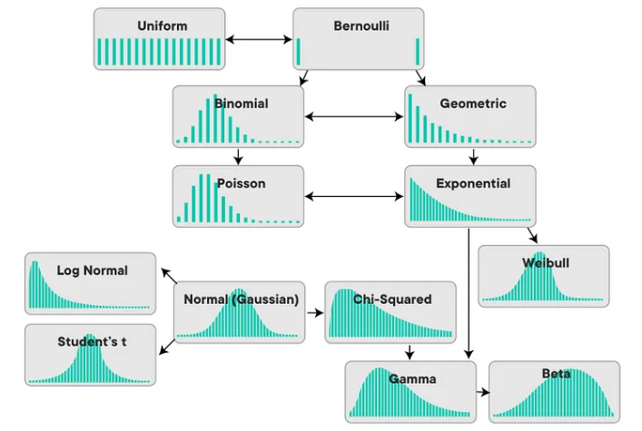
2. Statistical Models
2. Various statistical models
Probability Distributions
Statistical Models
RIDGE model
Multiple Regression Model
LASSO model
Generalized Linear Model
Elastic-Net Model
Logistic
Poisson
Generalized Additive Model
Time-Varying Coefficient Model

Slide 17
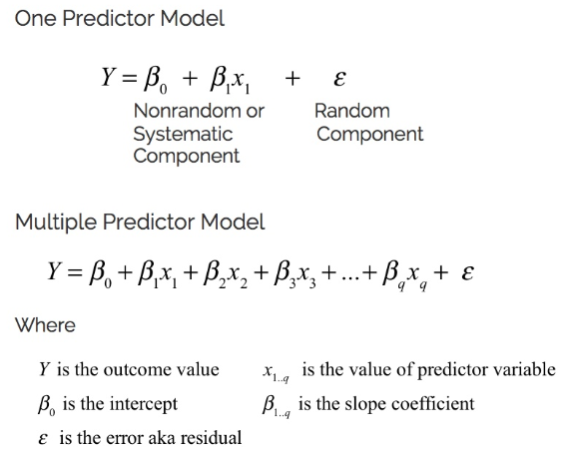
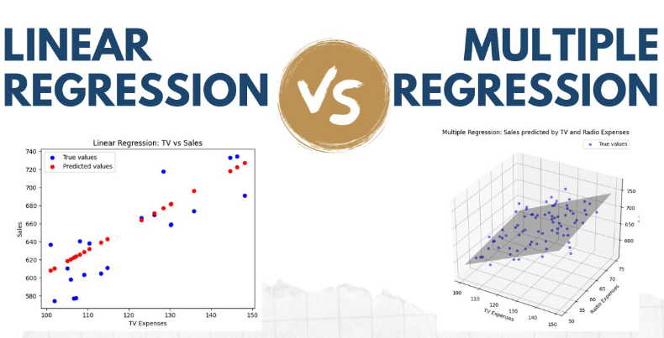
2. Statistical Models
2. Various statistical models
1) Multiple Regression Model

Slide 18
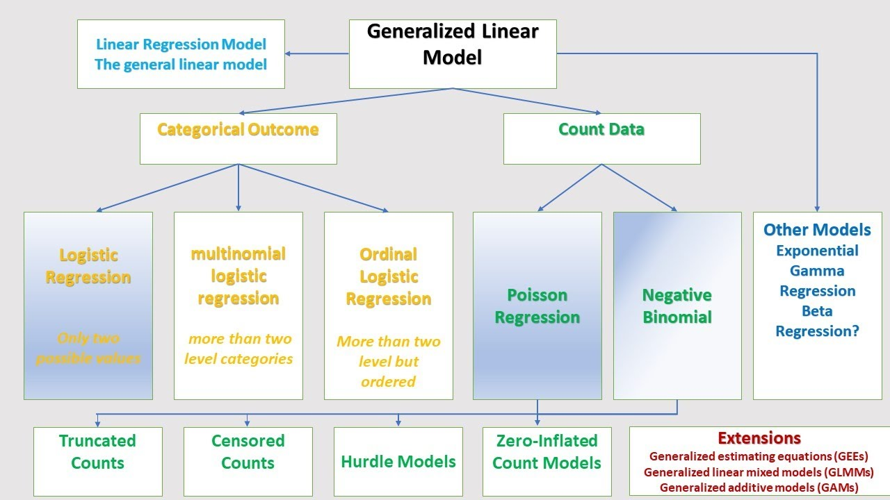
2. Statistical Models
2. Various statistical models
2) Generalized Linear Model

Slide 19
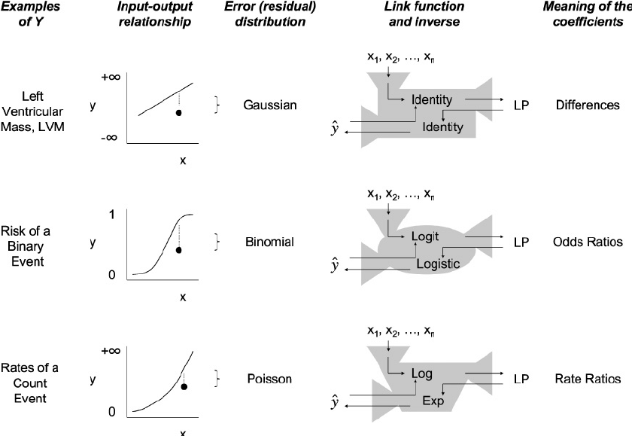
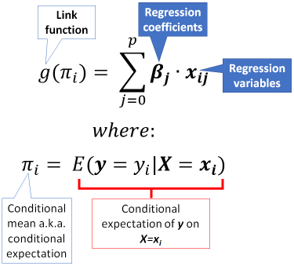
2. Statistical Models
2. Various statistical models
2) Generalized Linear Model

Slide 20
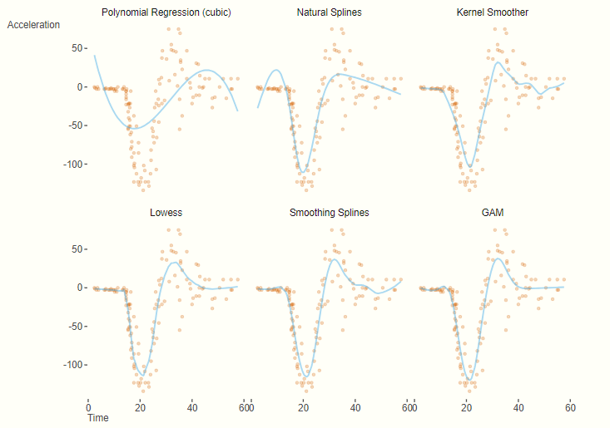
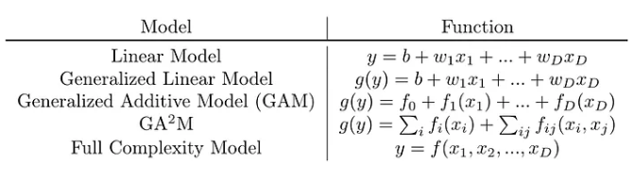
2. Statistical Models
2. Various statistical models
3) Generalized Additive Model

Slide 21
03
Machine Learning Algorithms

Slide 22
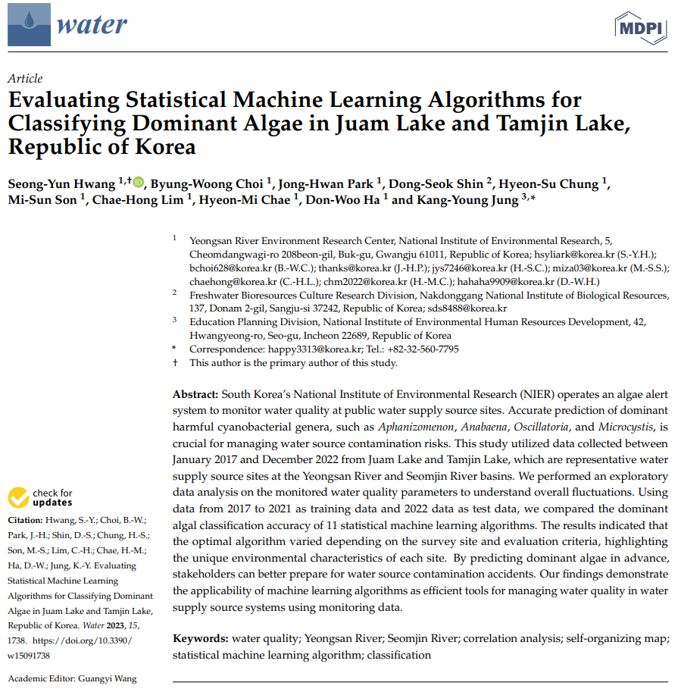
3. Machine Learning Algorithms
Evaluating Statistical Machine Learning Algorithms for Classifying Dominant Algae in Juam Lake and Tamjin Lake, Republic of Korea

Slide 23
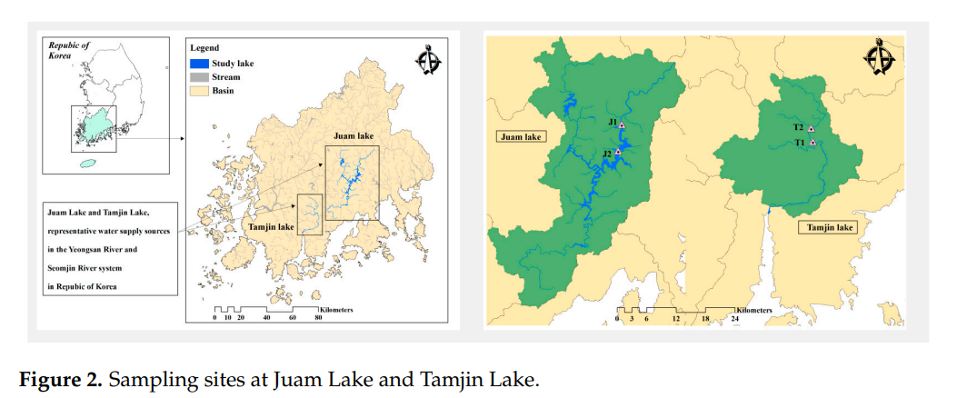
3. Machine Learning Algorithms
Evaluating Statistical Machine Learning Algorithms for Classifying Dominant Algae in Juam Lake and Tamjin Lake, Republic of Korea

Slide 24
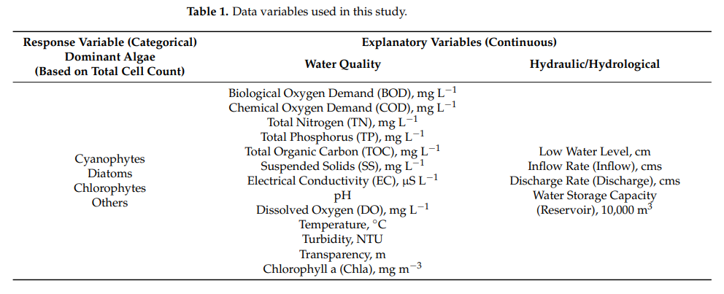
3. Machine Learning Algorithms
Evaluating Statistical Machine Learning Algorithms for Classifying Dominant Algae in Juam Lake and Tamjin Lake, Republic of Korea

Slide 25
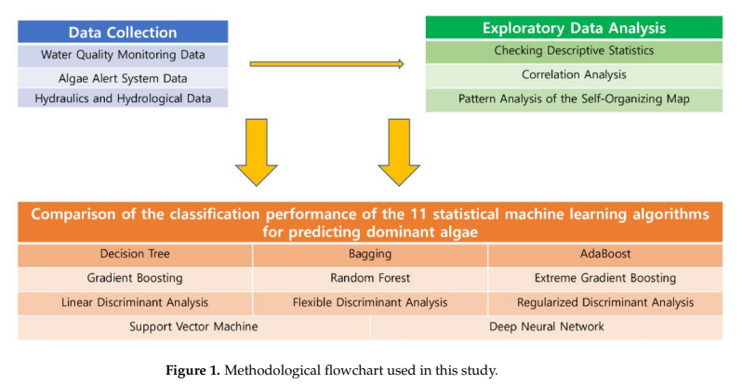
3. Machine Learning Algorithms
Evaluating Statistical Machine Learning Algorithms for Classifying Dominant Algae in Juam Lake and Tamjin Lake, Republic of Korea

Slide 26
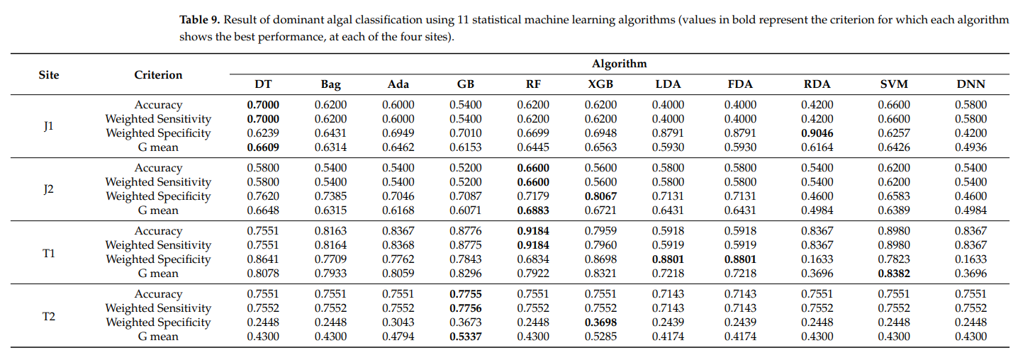
3. Machine Learning Algorithms
Evaluating Statistical Machine Learning Algorithms for Classifying Dominant Algae in Juam Lake and Tamjin Lake, Republic of Korea

Slide 27
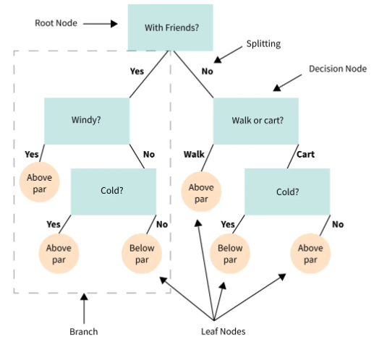
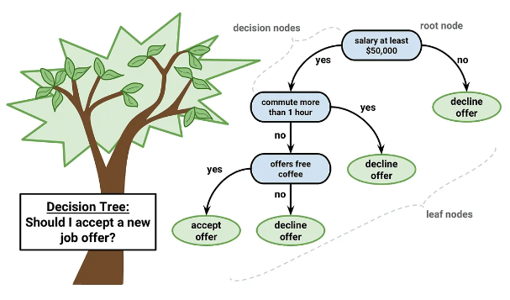
3. Machine Learning Algorithms
2. Various Machine Learning Algorithms
1) Decision Tree

Slide 28
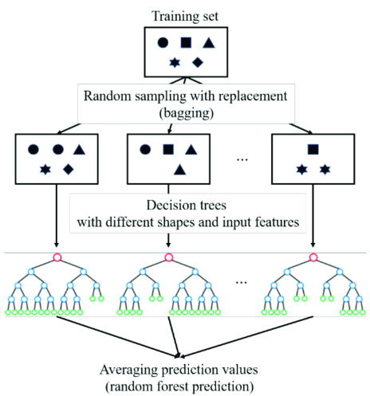
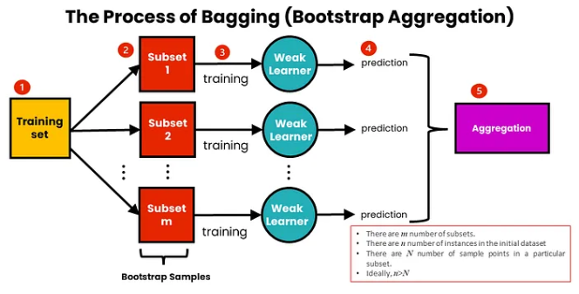
3. Machine Learning Algorithms
2. Various Machine Learning Algorithms
2) Bagging and Random Forest

Slide 29
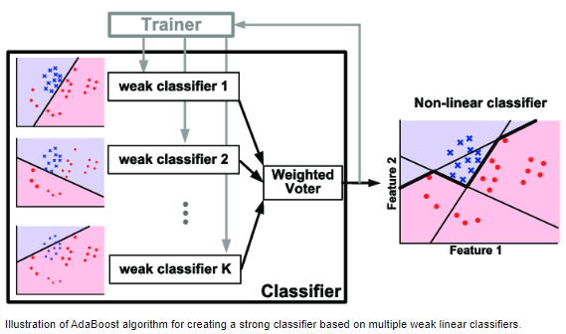
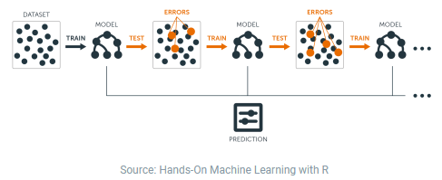
3. Machine Learning Algorithms
2. Various Machine Learning Algorithms
3) AdaBoost and Gradient Boosting

Slide 30
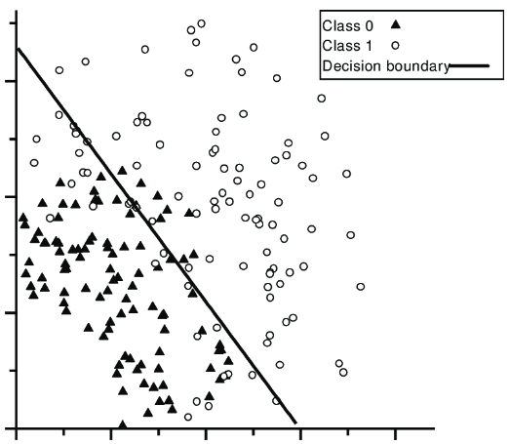
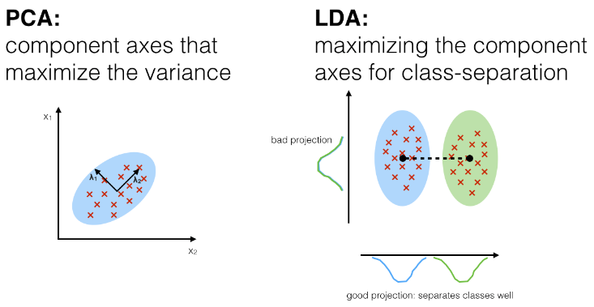
3. Machine Learning Algorithms
2. Various Machine Learning Algorithms
4) Discriminant Analysis

Slide 31
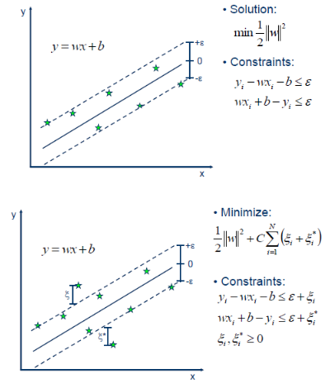
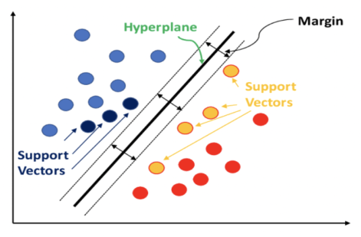
3. Machine Learning Algorithms
2. Various Machine Learning Algorithms
5) Support Vector Machine

Slide 32
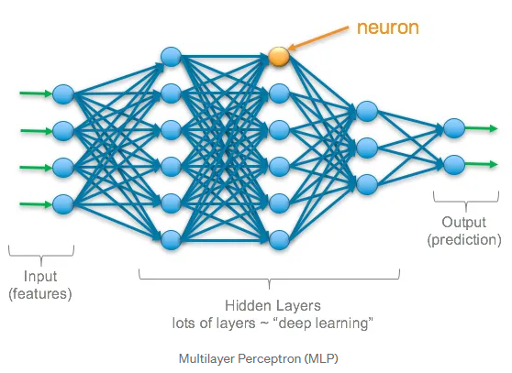
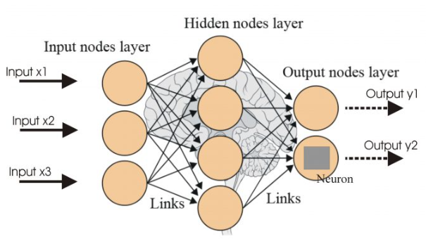
3. Machine Learning Algorithms
2. Various Machine Learning Algorithms
6) Deep Neural Network

Slide 33
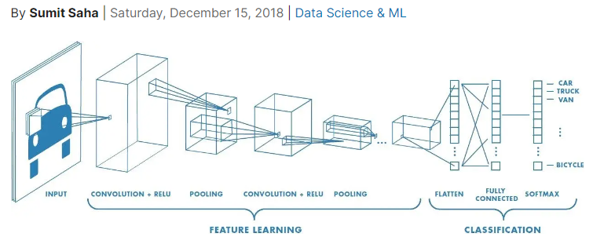
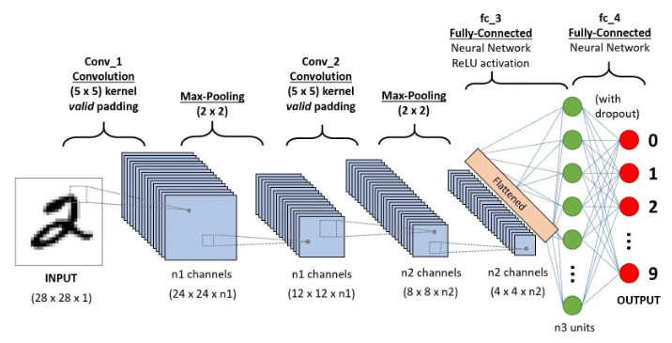
3. Machine Learning Algorithms
2. Various Machine Learning Algorithms
7) Convolutional Neural Network

Slide 34
감사합니다

